Slide 1
Butler Data Analytics Bootcamp Dashboard
Tableau Dashboard

Slide 2
Description of the Tools
For the dashboard visualization portion of our project, we will be using Tableau
Worksheets of individual visualizations will be created and then will be used to create a dashboard where they are displayed on the same visualization

Slide 3
Dashboard Data Structure
The dashboard will incorportate multiple interactive visuals displaying data from our datasets.
Data will come from multiple csv files and will be joined together in Tableau based on their primary keys.

Slide 4
Dashboard Design
Visualization 1
Display average movie ratings throughout history (by year)
Visualization 2
Display clustering model of average movie rating by genre
Will improve based on results of one hot encoder to split up genres
Visualization 3
Dashboard the overview of the data by rating and is filterable to display subsets of the data

Slide 5
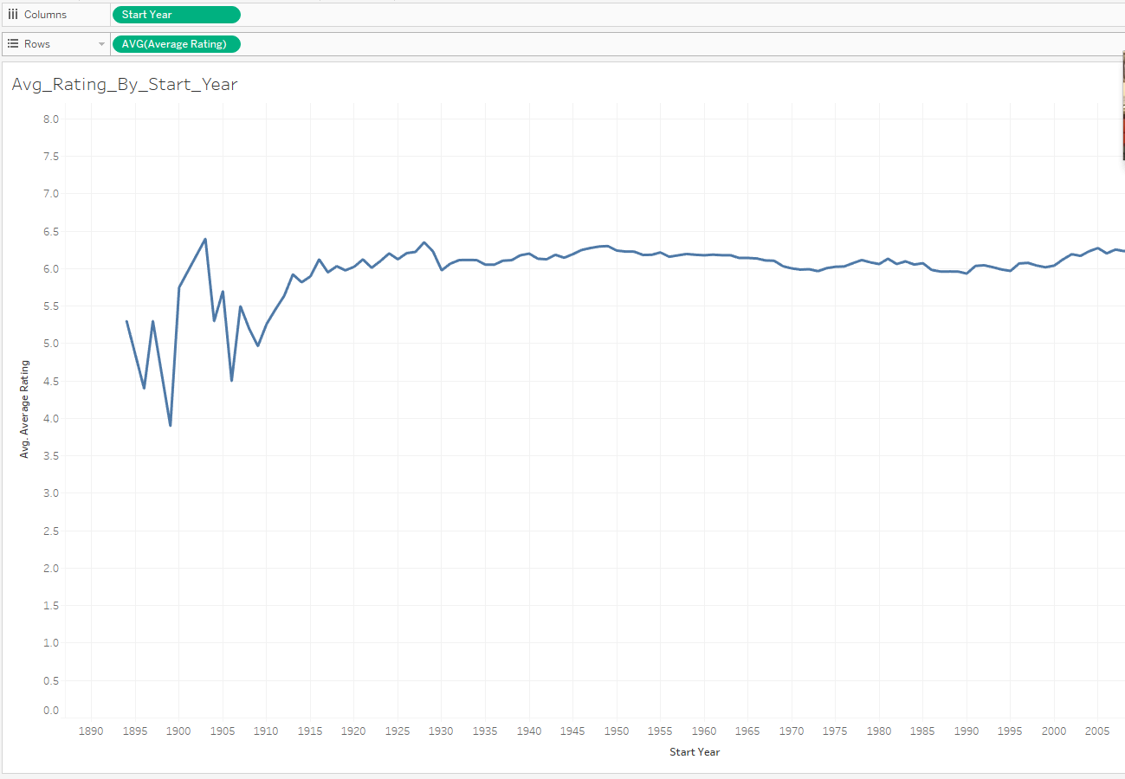
Example Visualizations - Avg Rating by Year

Slide 6
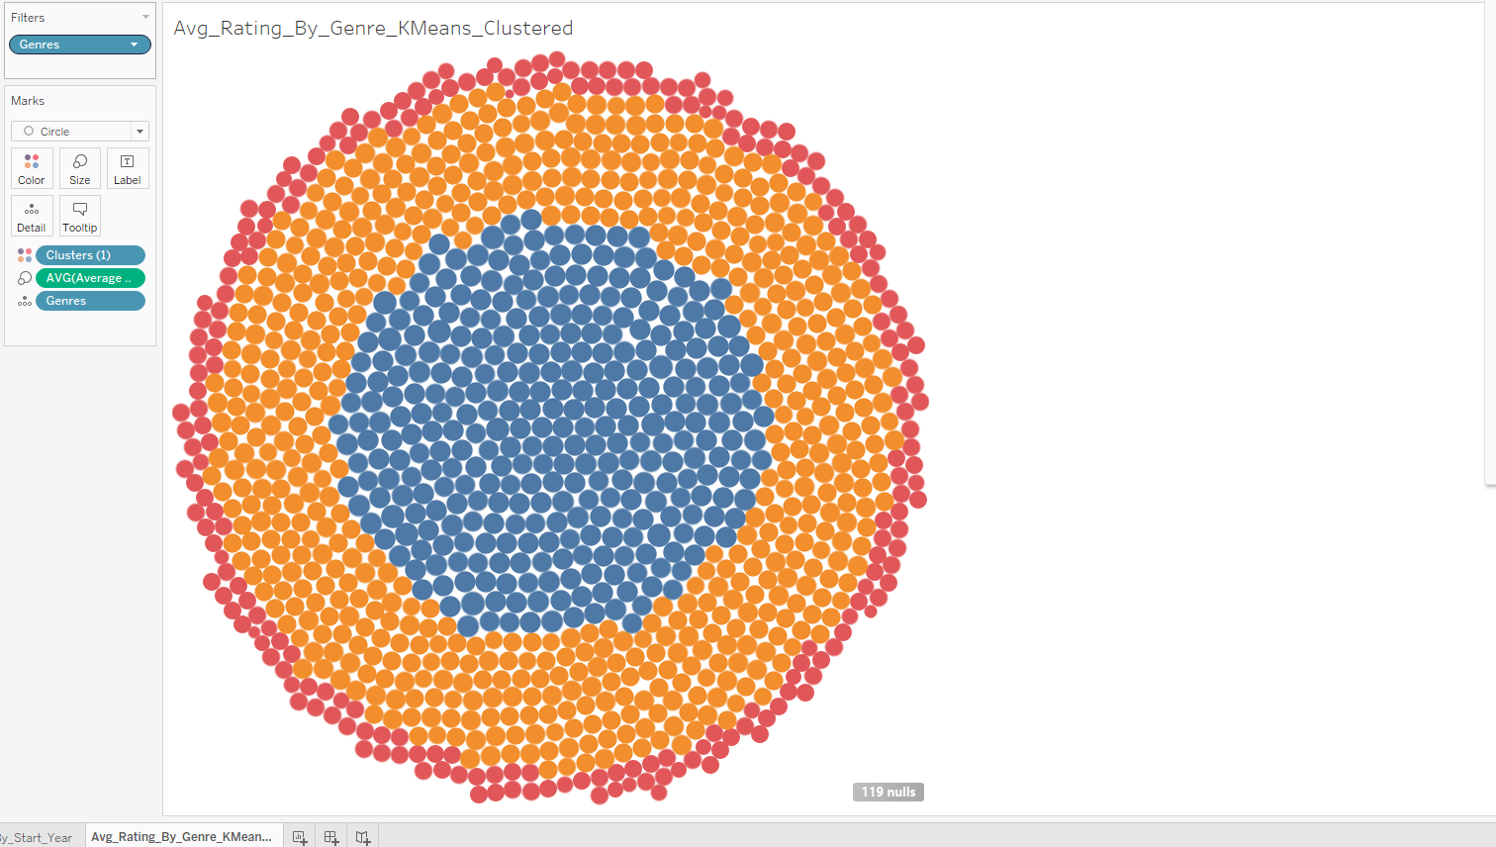
Example Visualizations - Avg Rating by Genre Clustered

